Slide 1


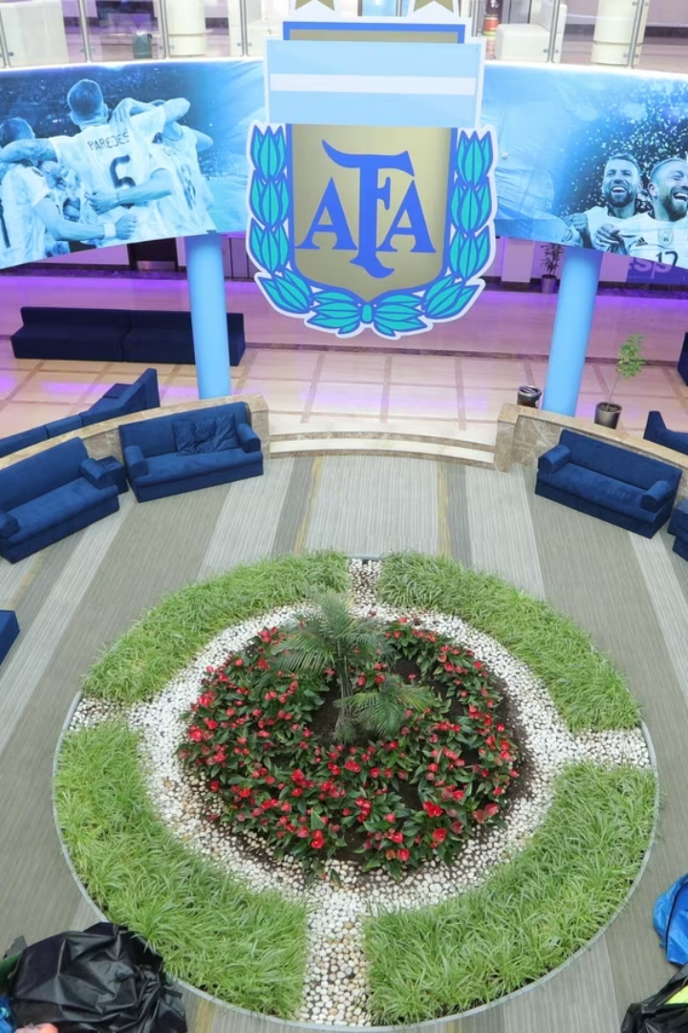
Game Changers: How Hosting National Teams during the World Cup Propelled Qatar University to Global Prominence
Presenters:
Dr. Hitmi Al-Hitmi, Director of Communication and Public Relations
Shaikha Al-Emadi, Head of Marketing

Slide 2
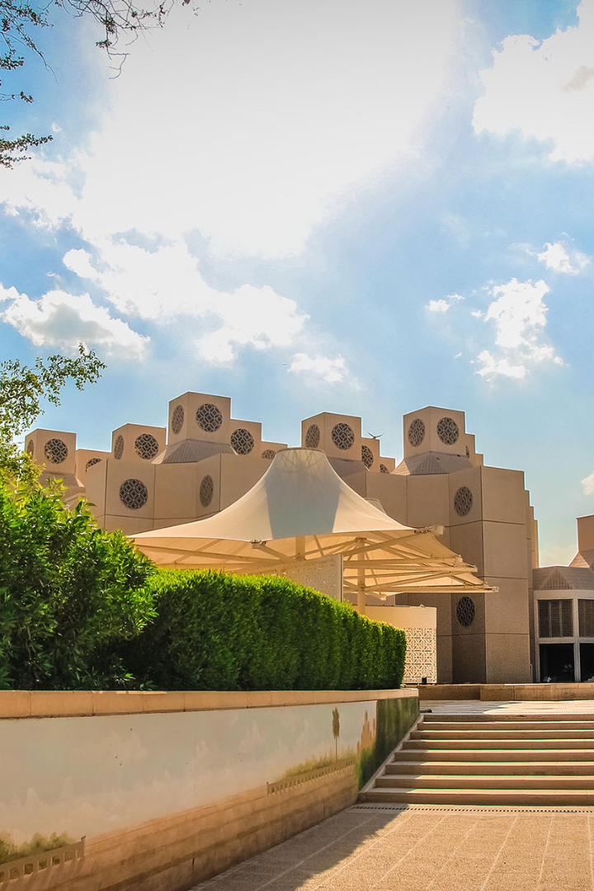
About Qatar University
Multicultural Community
Academic Excellence
Ranked #1 in MENA region,
24th Worldwide (THE Young University Rakings)
2nd in QS Arab Region University Rankings
Over 25,000 students originating from over 80 nations
Programs
Over 90 undergraduate and postgraduate programs across 11 colleges

Slide 3
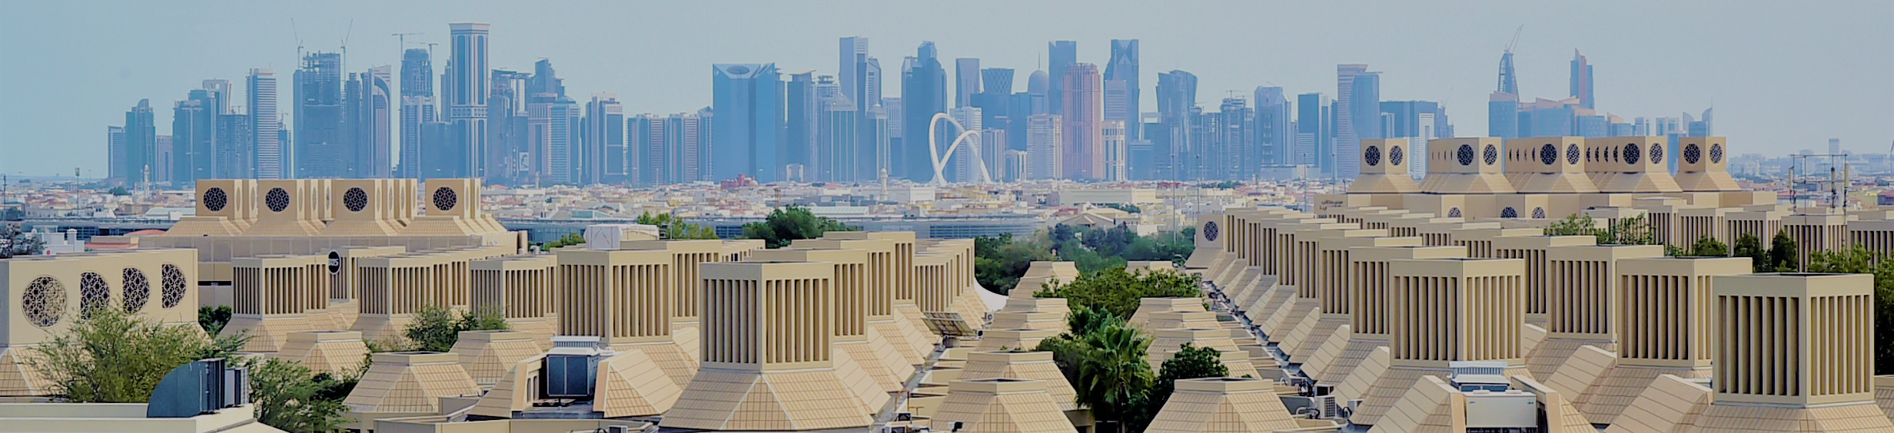
Innovation and Impact
Entrepreneurship Hub
Social Responsibility
Global Research Partner
Qatar University is committed to fostering entrepreneurship and innovation, providing students and faculty with the resources and support necessary to turn their ideas into reality.
Qatar University believes in the importance of social responsibility and encourages students and faculty to engage with local communities and address pressing social issues such as healthcare, education, and environmental sustainability.
Qatar University collaborates with leading universities and research institutions around the world, providing students and faculty with unparalleled opportunities to engage in cutting-edge research and make meaningful contributions to global knowledge.

Slide 4

Why Are We Here Today?
1
Value of Hosting Experience
2
Potential for Others
Emphasizing the significant potential that exists for other higher education institutions worldwide to gain from similar opportunities
Showcasing the exceptional value of Qatar University's hosting experience with the Spain and Argentina national teams during the World Cup
3
Inspiration for Universities
Inspiring universities to adopt major sporting events as a powerful platform for enhancing their reputation, fostering academic collaborations, engaging students, and establishing a legacy that endures

Slide 5
Using Sporting Events as a Platform for University Promotion
1
Enhancing Reputation
Hosting the teams raised QU's profile and attracted new students from around the world.
Fostering Collaborations
2
Hosting events and conducting research with experts from other institutions enhanced QU's academic reputation.
3
Engaging Students
Students participated in competitions, created artworks, and volunteered during events, fostering a sense of pride and belonging.
Establishing a Legacy
4
The university developed a number of new academic programs and research initiatives that are still in place today

Slide 6
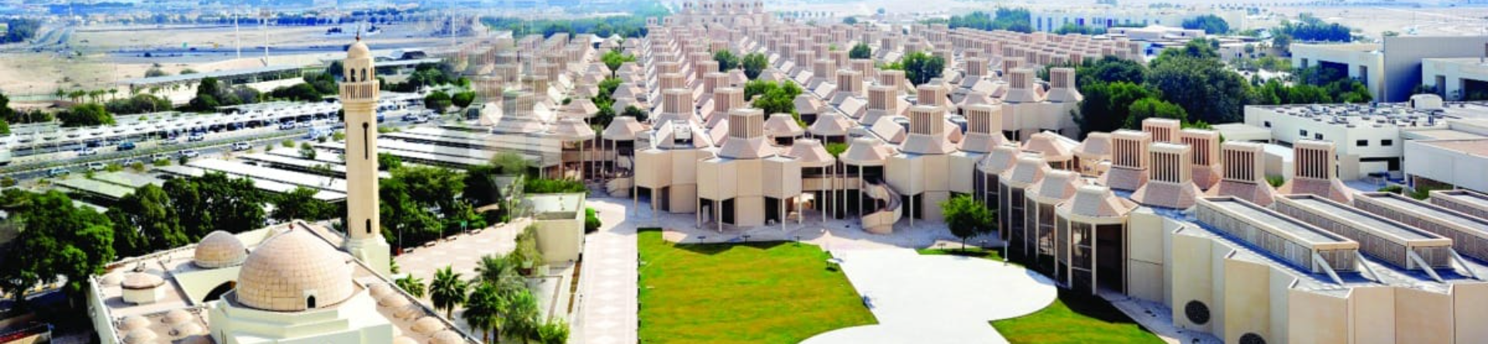
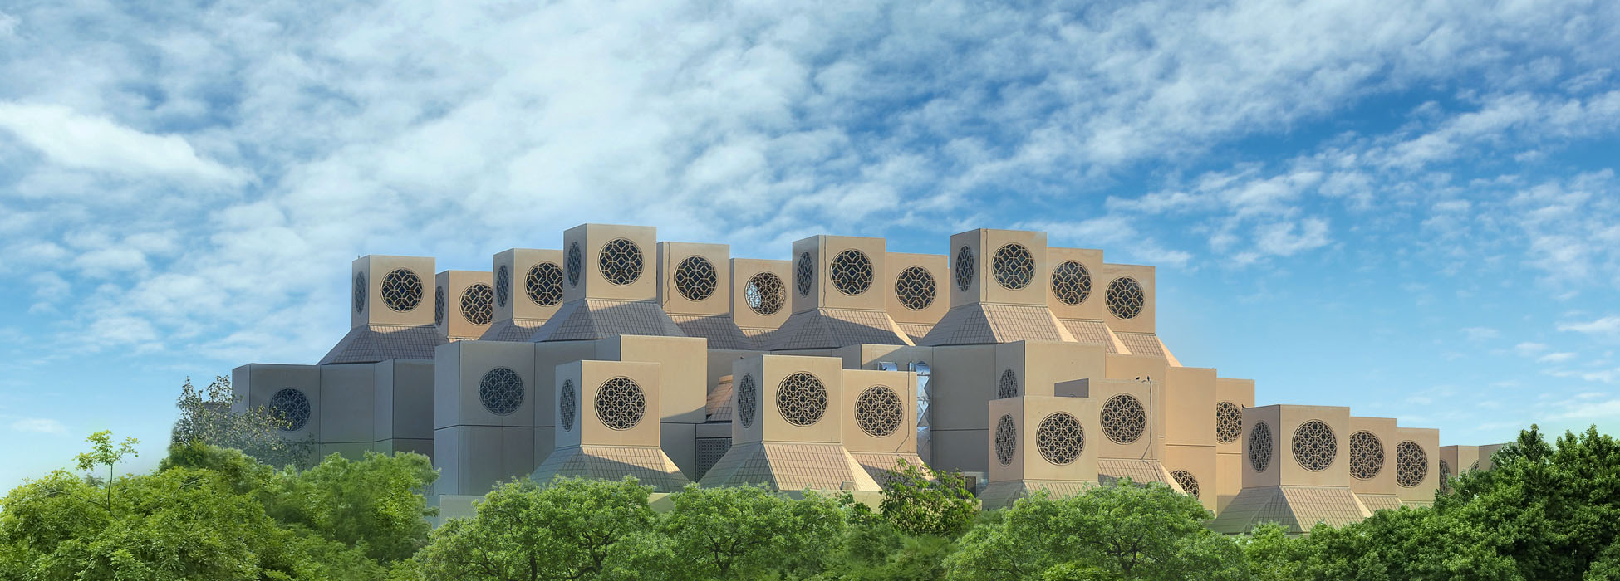
The Impact of FIFA World Cup 2022 on Qatar University
Notes:
Qatar's hosting of the 2022 FIFA World Cup is a story of challenge and determination, marked by success and excellence that have left long-lasting imprints on the pages of history. Since the moment of its announcement as the host nation in 2010, Qatar pledged to deliver an exceptional edition of the tournament. It set its goals, worked determinedly day and night, and fulfilled its promises. Its motto, "Expect Amazing ", was evident in all aspects, reflected in the impressive organization, smooth execution, large-scale attendance of spectators, and successful management of the tournament from its opening to its closing.
In view of its prominent position as the main national institution of higher education in the country that serves as a center of knowledge and a house of expertise, Qatar University participated alongside other State institutions in preparing for hosting the world's largest sports event, Qatar 2022 World Cup. The University conducted research and studies, organized seminars and workshops, provided ideas and consultations, and contributed to the success of the event, showcasing the State's ability to manage this global event and deliver a unique edition that the world has never witnessed before. We firmly believe in excellence and pursue it as a way of life and work approach and style.
The University's engagement was not limited to the preparation phase but extended to the heart of the sporting event, becoming an integral part of it. The University hosted the national teams of Argentina and Spain, providing them with accommodation, training facilities, and luxurious arrangements comparable to the finest hotels in the world. Additionally, the University hosted the training sessions of the Swiss and Dutch national teams without accommodation.
The selection of Qatar University to host these teams and the competition of these sports teams to be hosted by QU was based on its world-class sports infrastructure and specifications. The University also organized various events and programs to enrich campus life during the World Cup. For example, it held special activities for the international volunteers coming to Qatar, welcoming them at the University through entertainment programs to provide them respite after organizing matches and accompanying delegations, among other initiatives. This report will highlight the benefits, lessons learned, experiences, and relevant statistics associated with these efforts.

Slide 7



FIFA World Cup 2022
A Unique Opportunity
A Global Conversation
Notes:
Remove text

Slide 8
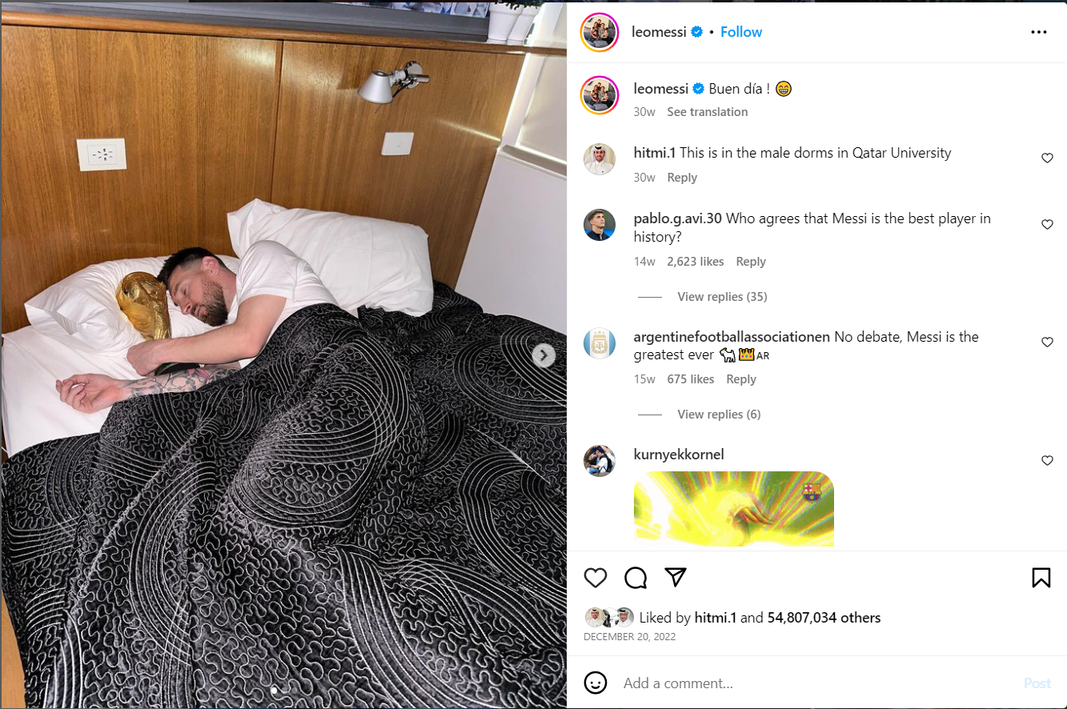

Enhancing Reputation through Media Exposure
Notes:
Add

Slide 9
Enhancing the Academic Collaborations
Research Collaboration
Papers and Publications
The university partnered with numerous organizations and institutions to research topics such as sustainability, health, environment and innovative technologies
QU published over 120 academic research papers on World Cup-related topics, cementing its reputation as a leader in sports studies.
1
2
3
4
5
Conferences and Workshops
Education Opportunities
Research funding
The university hosted various events and workshops for academic collaborations discussing the economic and social impact of the World Cup.
These collaborations strengthened academic reputation of QU and gave students the opportunity to learn from experts from other organizations.
Over 20 internal and external research projects on topics and innovations related to the FIFA World have been funded until 2023
Notes:
Collaboration:
the World Cup provided QU with opportunities to forge new collaborations, memorandums of understanding, and partnerships with various academic and non-academic institutions, both governmental and private. For instance, a memorandum of understanding was signed with the Ministry of Culture and Sports to strengthen cooperation, specifically in the development, organization, management, and implementation of training programs for professionals in the sports industry.
Papers:
Creating opportunities for research collaboration with international research organizations, facilitating knowledge exchange and improvement of practices.
Research and funding:
Increasing funding and resources for research projects related to health and well-being during the tournament, leading to advancements in this field.
Consequently, the recognition of Qatar University and its research programs as well as its scientific reputation has increased.

Slide 10
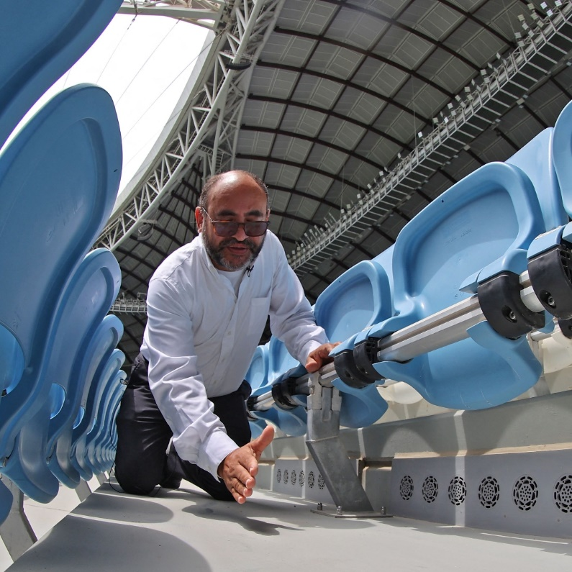
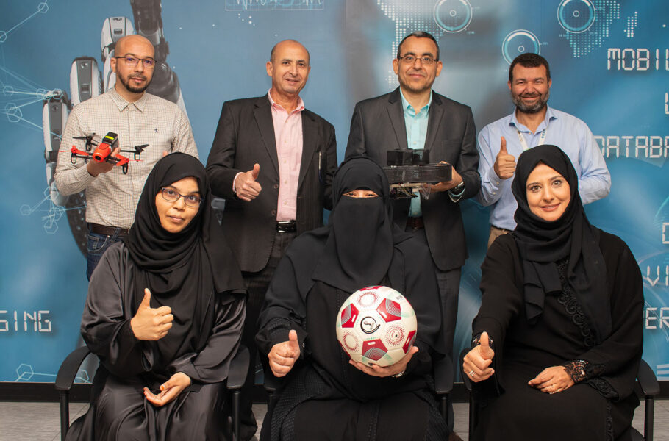
Fostering Innovations and Shaping a Legacy
Stadium Cooling system
Audience Management Technology

Slide 11
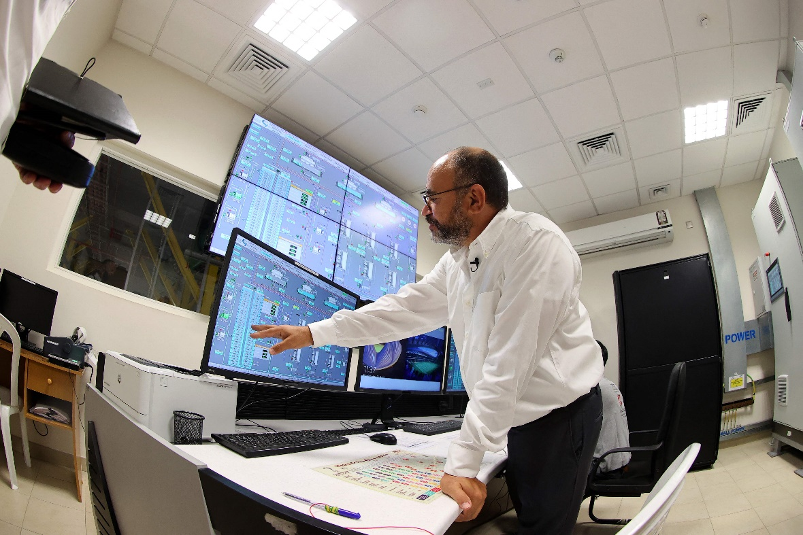

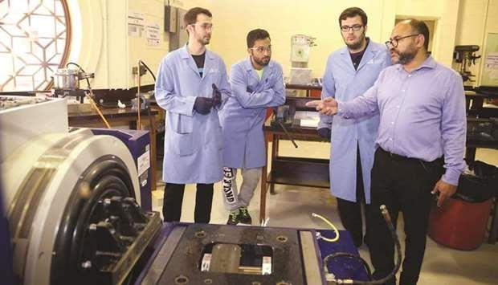
Qatar University Contribution in Making the World Cup Sustainable
Dr. Saud Abdul-Ghani's (Dr. Cool) implemented the innovation in collaboration with the Supreme Committee for Delivery and Legacy, a dual-purpose cooling system was developed for stadiums. It purifies and cools air, expelling hot air while recycling it. The system's design, based on 3D models of stadiums, considers wind strength and shadow patterns. Sensors monitor temperature, humidity, and air quality, ensuring a 20-24 degrees Celsius range during FIFA matches.

Slide 12
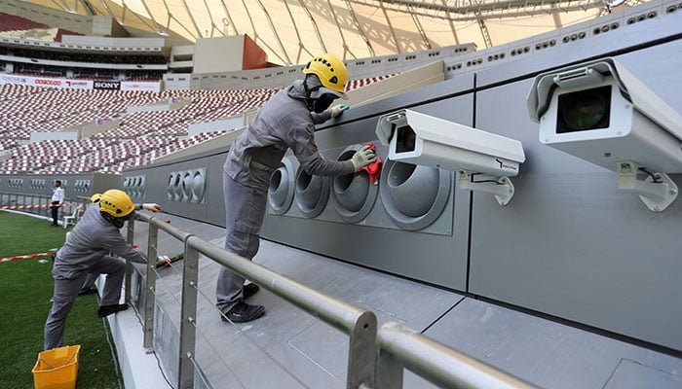
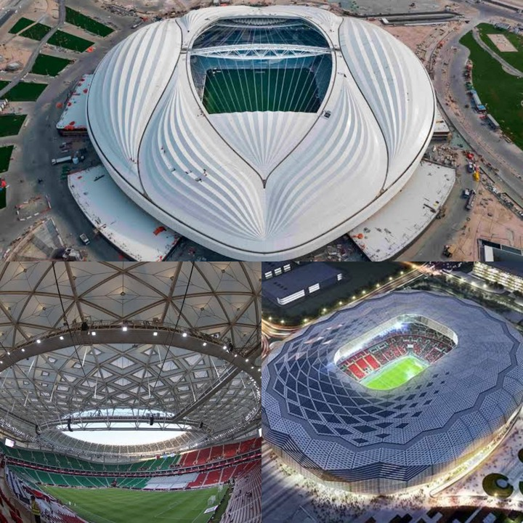
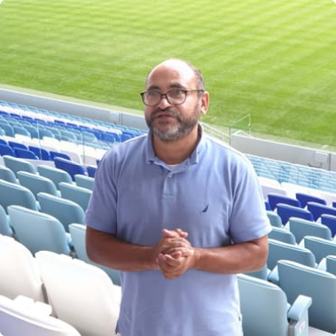
Energy Efficiency
Sustainability Goals
Research and Development
The cooling system introduced by Dr. Abdul-Ghani saves energy by reducing the amount of water used in stadium cooling.
The use of the new cooling system helped Qatar meet its sustainability goals for the 2022 World Cup.
QU has formed partnerships with other institutions to conduct further research and development on sustainable stadium cooling.

Slide 13

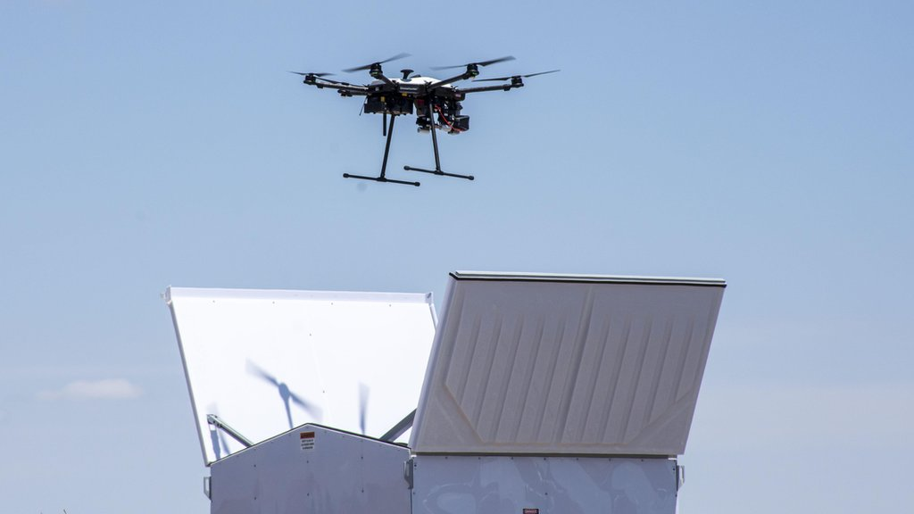
Enhancing Audience Management through AI Technology
the research team led by Dr. Sumaya Al-Maadeed, faculty of the College of Engineering at Qatar University, in collaboration with the Supreme Committee for delivery and legacy, has developed intelligent audience management and control systems, which consist of many different elements used to calculate the number of audience, facial recognition technology and detect abnormal incidences.

Slide 14
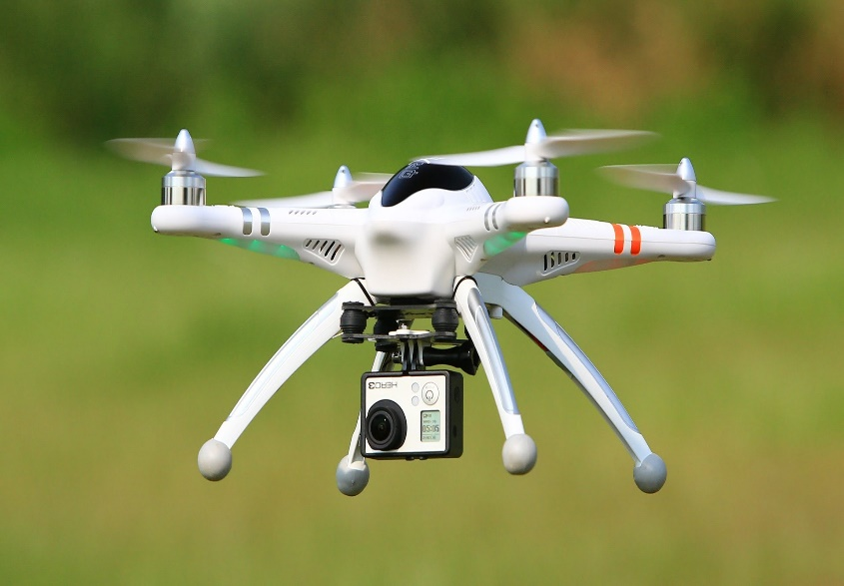
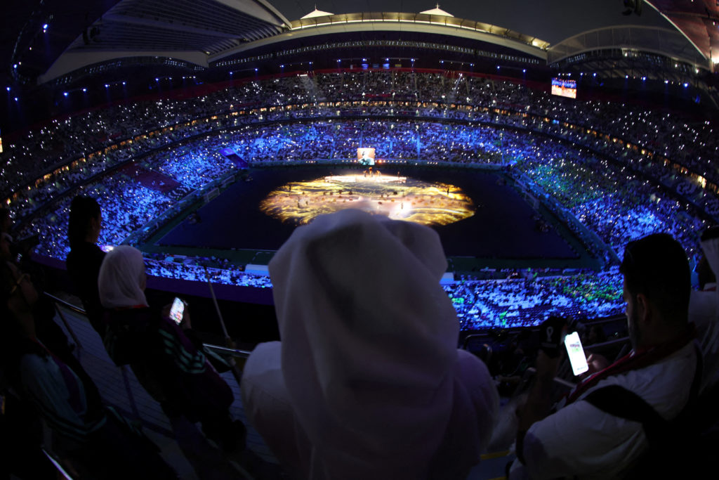
Leveraging AI & Advanced Technologies
for Event Security
Innovations in Safety and Security
Detecting abnormal incidences; tracking and identifying suspicious individuals via facial recognition tools; ensuring fan privacy by processing locally recorded data through advanced computing platforms.
The research team has pioneered a system that uses drone-collected data to monitor audiences, applying deep and extended neural networks to estimate audience density.

Slide 15
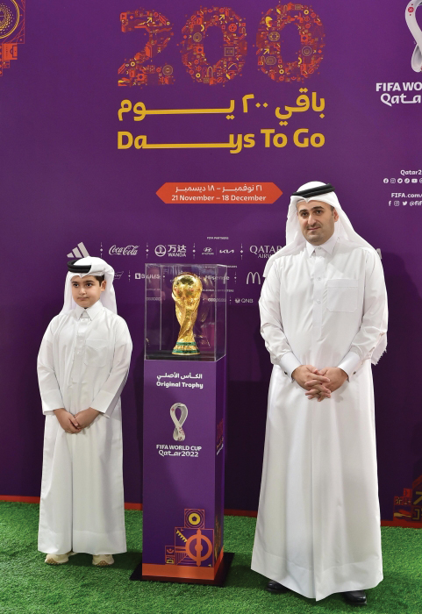
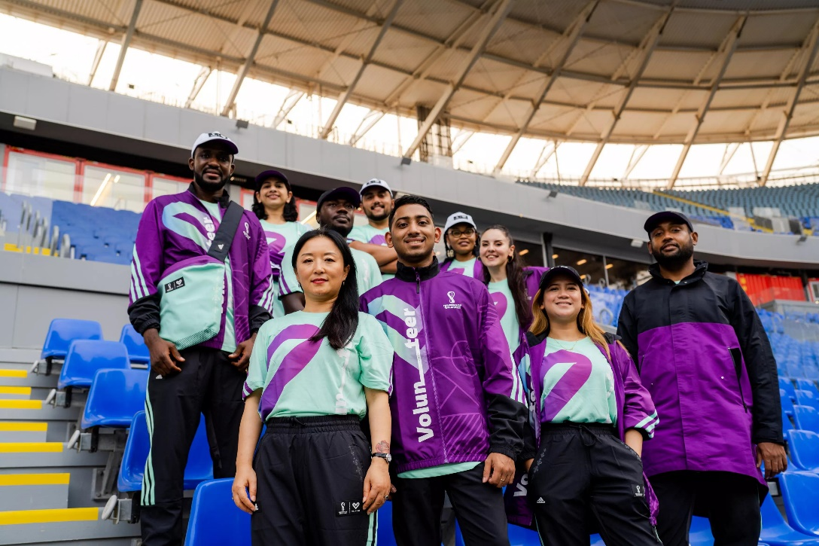
Amplifying Impact Through Community Engagement
Organizing the World Cup Tour
at Qatar University
Empowering Volunteers for World Cup Success
Showcased the original World Trophy on campus where students, staff, and administrators had the opportunity for close observation and photos with the trophy
Volunteer registered in FIFA databased was over 3350 individuals from QU.
Core Curriculum Program is now offering a new community service-based learning course.
Notes:
Organizing the World Cup tour at Qatar University: The University, in collaboration with the Supreme Committee for Delivery and Legacy, hosted the World Cup promotional tour event, which featured the original World Trophy, one of the most well-known football symbols in the world, on the university campus. The Golden Trophy was available for close observation by students, academic staff, and administrators, who also got the chance to take photos with the Trophy.
Conducting Courses and Workshops for Volunteers to Ensure the Success of the World Cup: As part of QU’s Core Curriculum Program participation in the Qatar 2022 FIFA World Cup through offering the community service-based learning course UNIV220 to its students, the Core Curriculum Program, in collaboration with the Supreme Committee for Delivery and Legacy, organized an event to support and assist more than 300 students in the volunteer registration process. This event took place at Ibn Khaldon Building from September 11th to 14th, 2022. The student registration process began in June, and most of them received volunteer offers at World Cup stadiums after passing personal interviews with FIFA. The students started volunteering at the stadiums in November, coinciding with the start of the World Cup, under the supervision of faculty members from Qatar University's Core Curriculum Program. The statistics for QU’s volunteers in particular at the World Cup are provided below:
The total number of people registered in the database for the tournament was 3363 people from Qatar University.

Slide 16
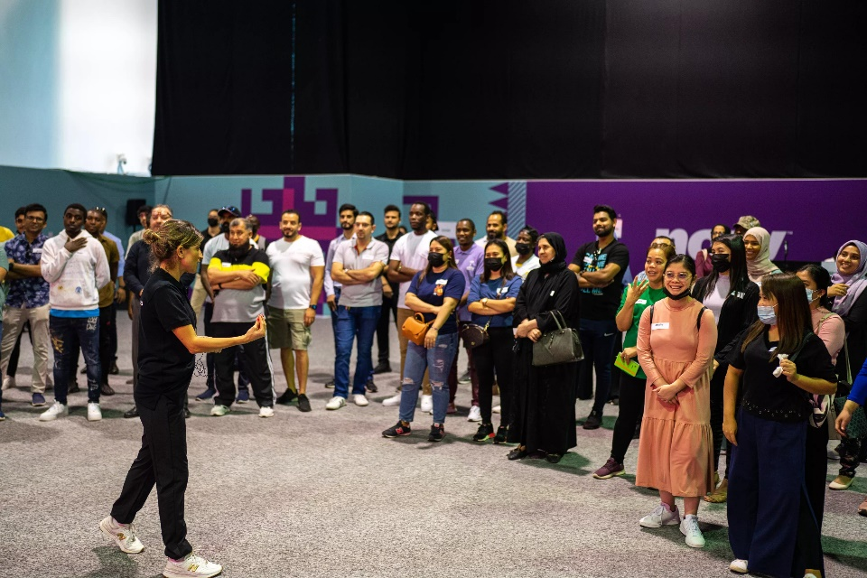
Amplifying Impact Through Community Engagement
Career Development Opportunities
Creative brilliance on display
QU Career Development Center facilitated paid field training in cooperation with FIFA and the Supreme Committee for Delivery and Legacy
QU students creations transformed the atmosphere, leaving a lasting impression on all who immersed themselves in this celebration of sports and creativity.

Slide 17
Conclusion
Global Prominence
Collaboration and Legacy
Celebrating Academic Excellence
Hosting major sporting events presents a unique opportunity for universities to gain global prominence, attracting new students and showcasing their academic excellence on a global stage.
Major events foster academic collaboration, student engagement, and create a lasting legacy that benefits the institution and society as a whole, reinforcing the university's commitment to excellence and its impact beyond the event.
create a platform to celebrate academic achievements and highlight research collaborations with global partners, inspiring students to engage in global issues and driving innovation.
Expanding Opportunities
Hosting major sporting events opens doors for increased opportunities for university students and alumni, providing a platform for personal growth, networking, and showcasing their talents and skills to a global audience.

Slide 18
Higher Education's Impact on the World
1
Addressing Global Issues
Higher education institutions leverage sport to address global challenges, empowering students as change-makers and fostering a generation committed to solving pressing issues.
2
Promoting Ethical Values and Humanity
Through education and advocacy, higher education institutions cultivate integrity, fairness, social justice, and athlete welfare, harnessing the power of sports for positive societal impact.
3
Advancing Knowledge
Through impactful research, higher education institutions expand knowledge on the multifaceted impact of sporting events, driving evidence-based decision-making and innovations for the betterment of society.
Q&A

